Slide 1
STUDENT DETAILS:
Name: Dasari Siva Nageswara Rao
SkillsBuild Email ID: siva.nag33363@gmail.com
College Name: Vignan’s LARA Institute of Technology & Science
College State: Andhra Pradesh
Domain: Frontend Development (15-06-23 to 20-07-23)

Slide 2


Clone

Slide 3



SIMPLE YOUTUBE CLONE BASED ON MODERN WEB TECHNOLOGIES

Slide 4

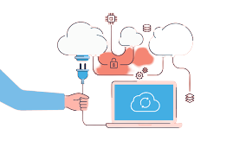
PROJECT TOPIC
With new standards emerging in Web Technology,
responsive web design has become very easier than before.
This project aims to replicate the YOUTUBE website with as less Javascript as possible.

Slide 5










AGENDA
New web technologies introduced, like CSS animations and transitions are very useful in designing new age, modern websites with great UI.
These, combined with a powerful Javascript API like IntersectionObserver will help developers in making animations smoother and less expensive in terms of resource usage.

Slide 6

PROJECT OVERVIEW
This website is a complete clone of the original YOUTUBE website along with its animations and background images.
It aims to be responsive and less resource intensive version of the original website.

Slide 7

WHO ARE THE END USERS?
Social enthusiasts and Front End Web developers can both enjoy the look and feel of the website.
New learners can also learn more about practical usage of CSS animations and transitions.

Slide 8
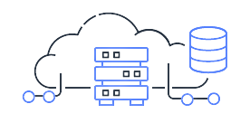
SOLUTION AND PRESENTATION
The website consists of CSS animations and new flexbox layouts.
New HTML semantic elements and IntersectionObserver API prevents unecessary workarounds.

Slide 9



WOW IN SYSTEM
Responsive
Quick loading
Removal of external libraries
Native CSS animations
Minimizing resource usage

Slide 10
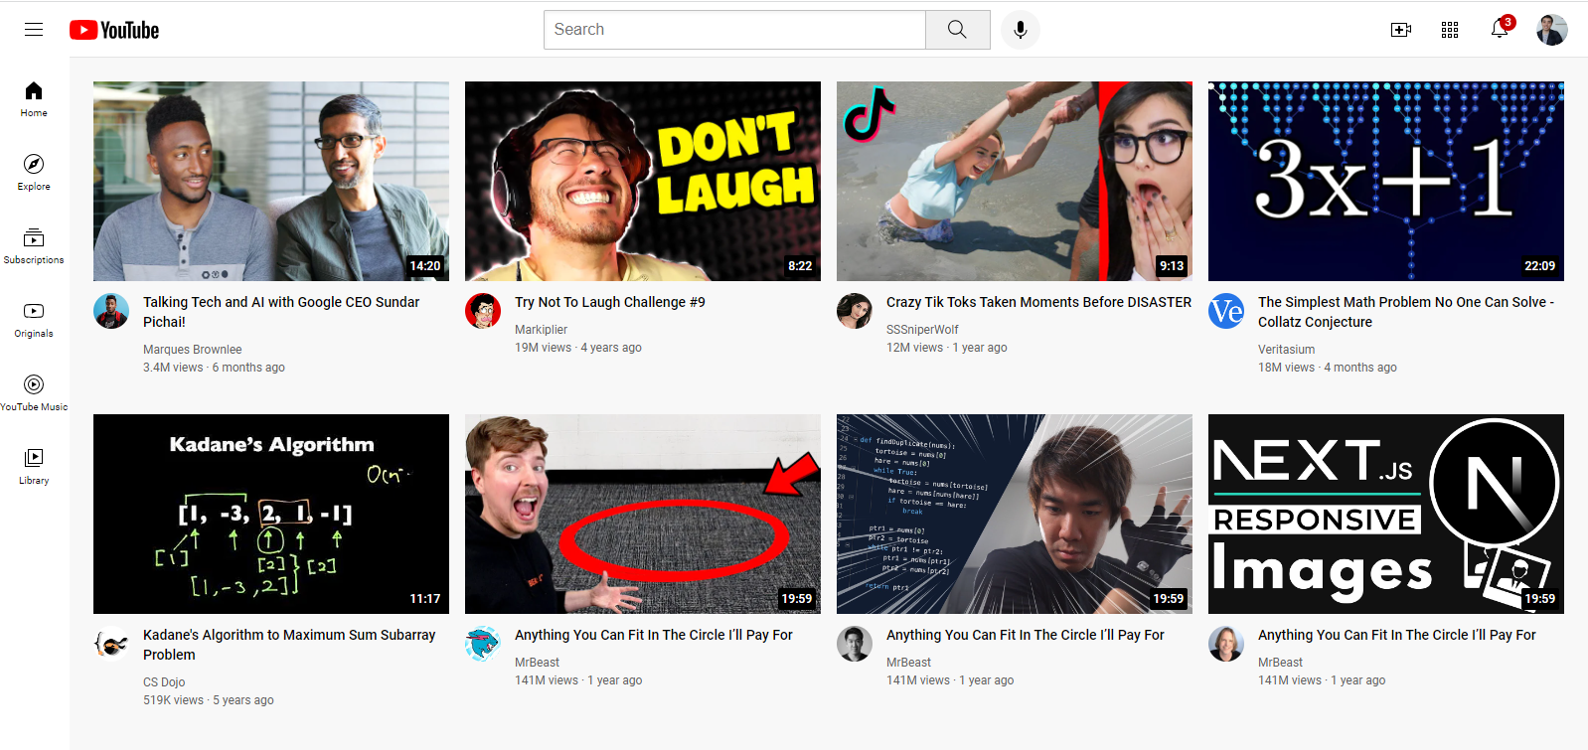
MODELLING
Desktop View:

Slide 11










RESULTS
We were able to create a responsive website with minimal JS and CSS media queries.
No external libraries were used and the font used is also open source.

Slide 12


LINKS
GitHub Repository:
https://github.com/saisrinivas06/youtube-clone
Live website, hosted at:
https://youtube-clone-ruby-ten.vercel.app/
Hosted by

Slide 13

THANK YOU

